Slide 1
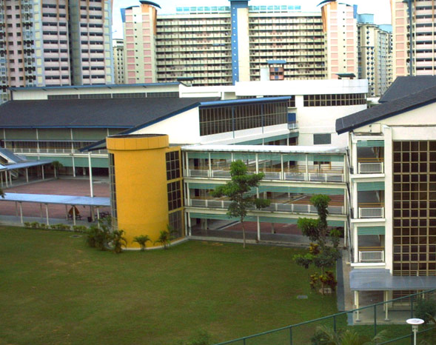
Singapore Schools
Does schools sufficiently provide enrichment to students

Slide 2
Introduction
Dataset:
Taken from Kaggle.com
5 tables
General information of schools
Subjects_offered
Moe_programmes
Distinctive_programmes
Cca
Persona: I work for a private education company
Objective: to provide enrichment programmes to students to enhance their educational journey

Slide 3
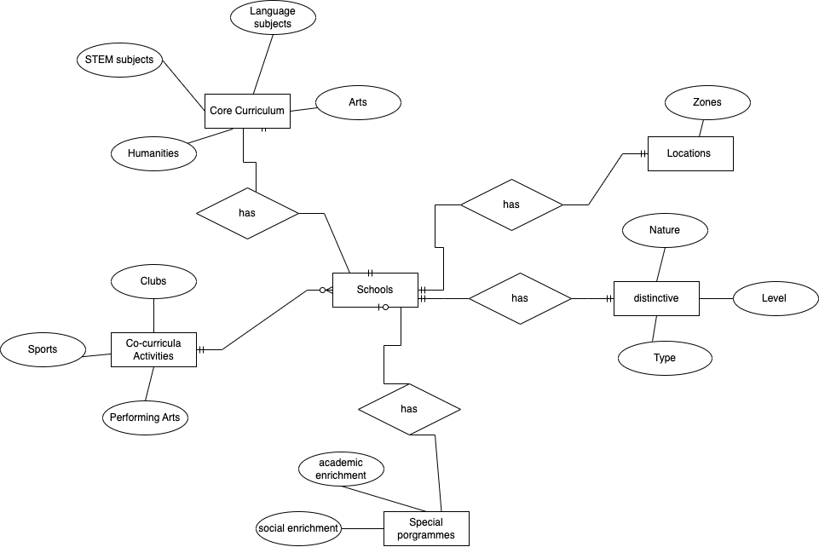
Entity Relationship Diagram

Slide 4
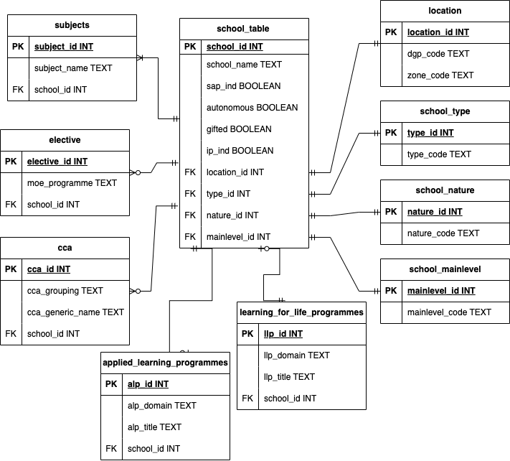
Schema

Slide 5
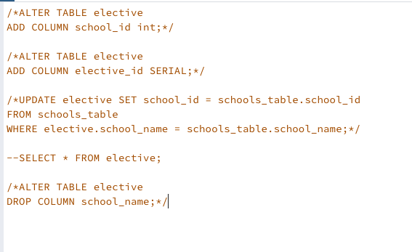
Data Cleaning
Originally 5 tables which I split into 10 to ensure 3NF
Linking the tables
Dropping columns that I did not need
Setting data type
Challenges:
While trying to link my tables to the general information table, I was encountering an error message in postgres that said "schools.school_id " does not exist. It took me a long time before I realise that it was because there was a space in the header and that I needed to upload the csv again without the space.

Slide 6
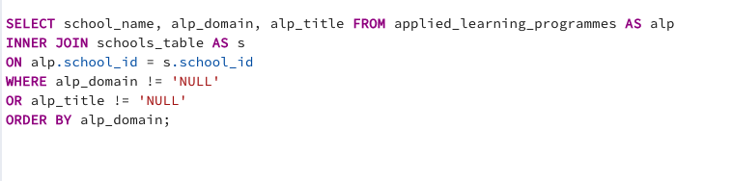
Special Programmes – Applied Learning
Analysis
Of the schools that have special applied learning programmes, what are the areas of enrichment?

Slide 7
Greater emphasis on STEM

Slide 8
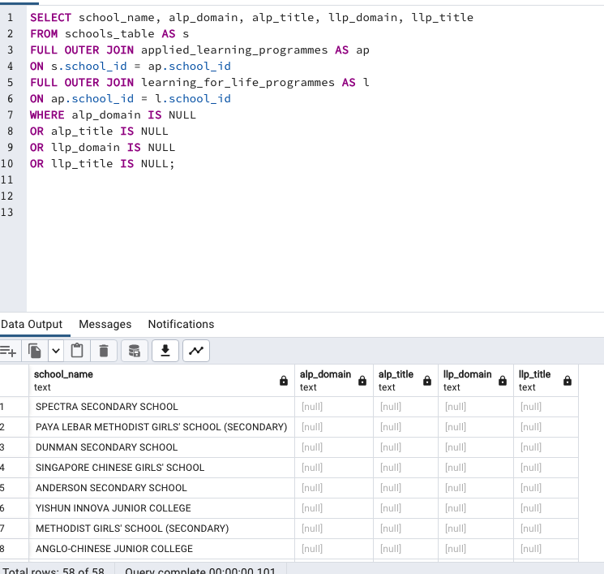
How many schools in Singapore does not have special enrichment programmes?
58 of 346

Slide 9
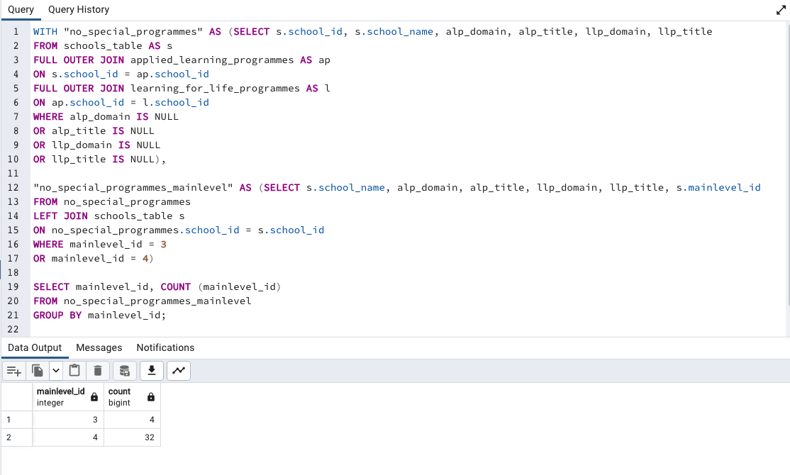
What main level are the schools that do not have special programmes?
32 Secondary Schools

Slide 10
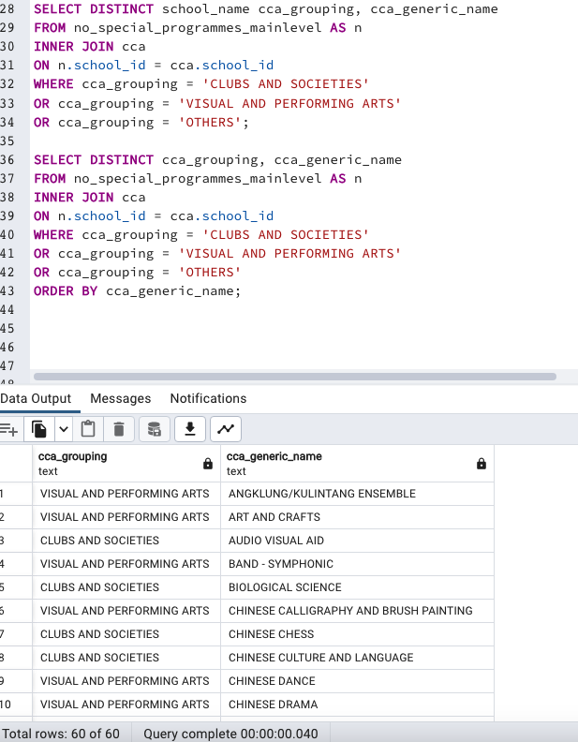
Of these schools with no special programmes, what are the ccas they provide
I looked mainly at clubs, arts & others. Not too diverse

Slide 11
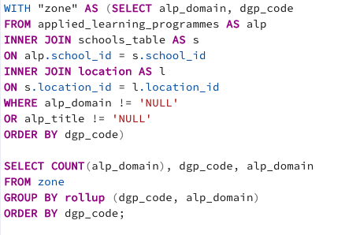
Where are the schools with special programmes located?

Slide 12
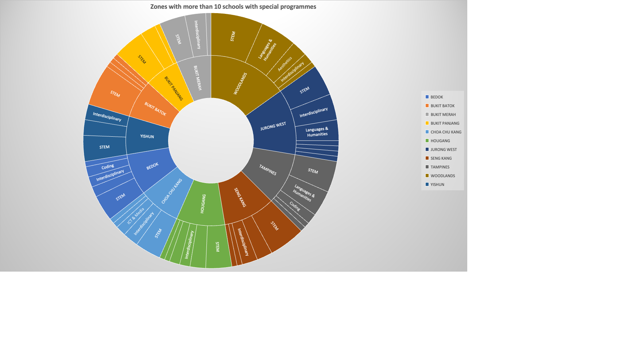

Slide 13
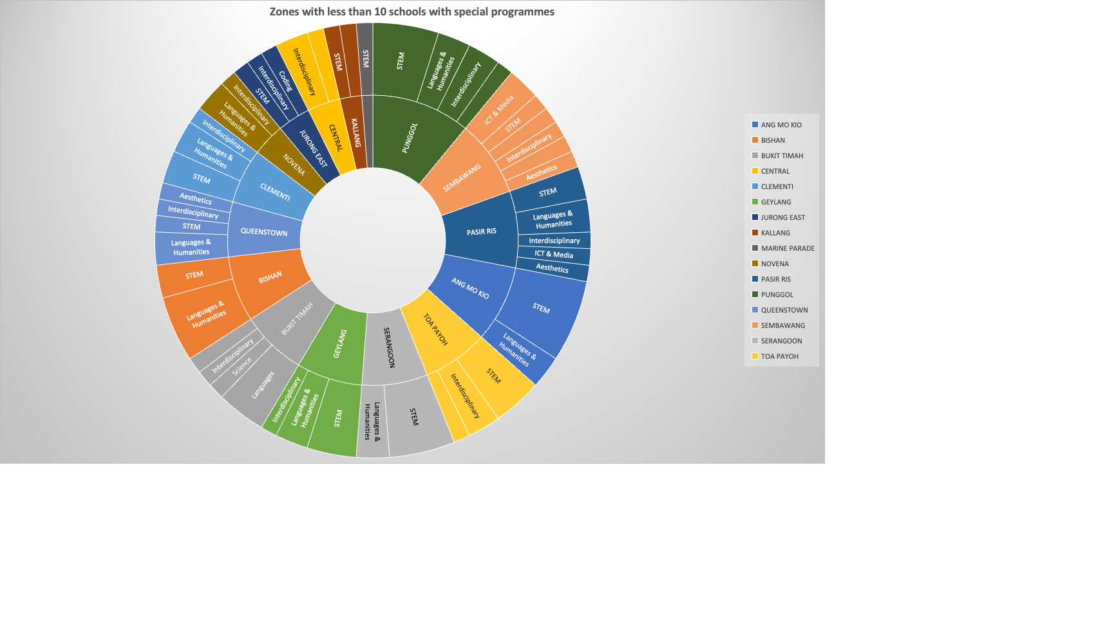

Slide 14
Proposal
Start our first enrichment programme targeted at the secondary level
To focus on language & humanities but also to provide STEM or interdisciplinary programmes according to the students’ interests
To open our first center in a zone with less than 10 schools with special programmes : Jurong East, Ang Mo Kio, Serangoon may be good options

